Slide 1
EE 521/ECE 582 – Analysis of Power systems
Class #12 – October 4, 2022
Dr. Noel N. Schulz
Edmund O. Schweitzer III Chair in
Power Apparatus and Systems
Chief Scientist Joint Appointment, PNNL
Co-Director, PNNL/WSU Advanced Grid Institute (AGI)
Washington State University Pullman
Noel.Schulz@wsu.edu EME 35
509-335-0980 (o) and 509-336-5522 (c)

Slide 2
Reminders
Student Hours This Week & Next
Tuesday 4:30-5:30 pm (after class) – Zoom or EME 35 Pullman
Wednesday 4-5 pm Zoom or EME 35 Pullman
Friday 1:30-2:30 pm Zoom or EME 35 Pullman
Remember the Discussion Set Assignment
9/30 Summary, 10/4 Questions, 10/11 Discussions
Final Paper – Think about Topic - Oct 14
NAPS or WPRC Next week?

Slide 4
1
2
13
3
4
5
Insert A(1,4) = -11
-11
6
7
8
9
10
11
12
SAME
13
2
13
0
4
5
0
7
0
9
0
11
12
0
3
10
0
8
11
0
6
9
0
5
0
12
0
3
10
0
8
11
0
6
9
0
0
12
0
3
10
0
8
11
0
6
9
0
0
12
0
NIC=
NIC=

Slide 5
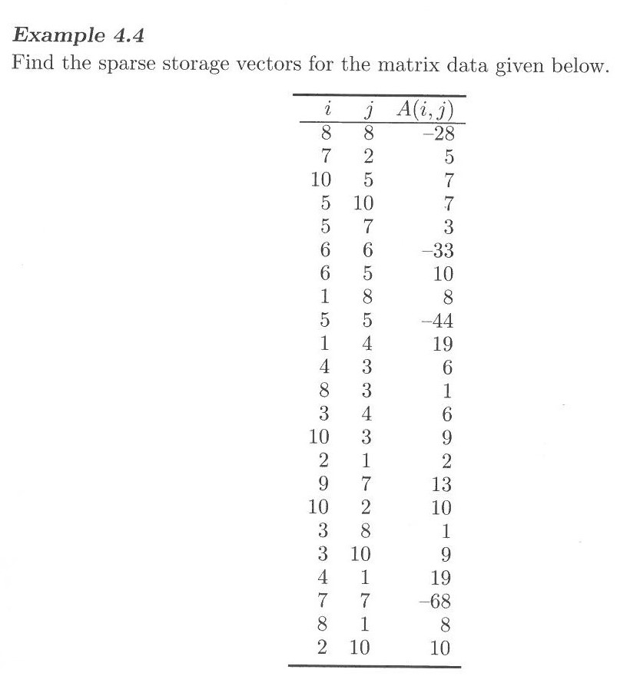
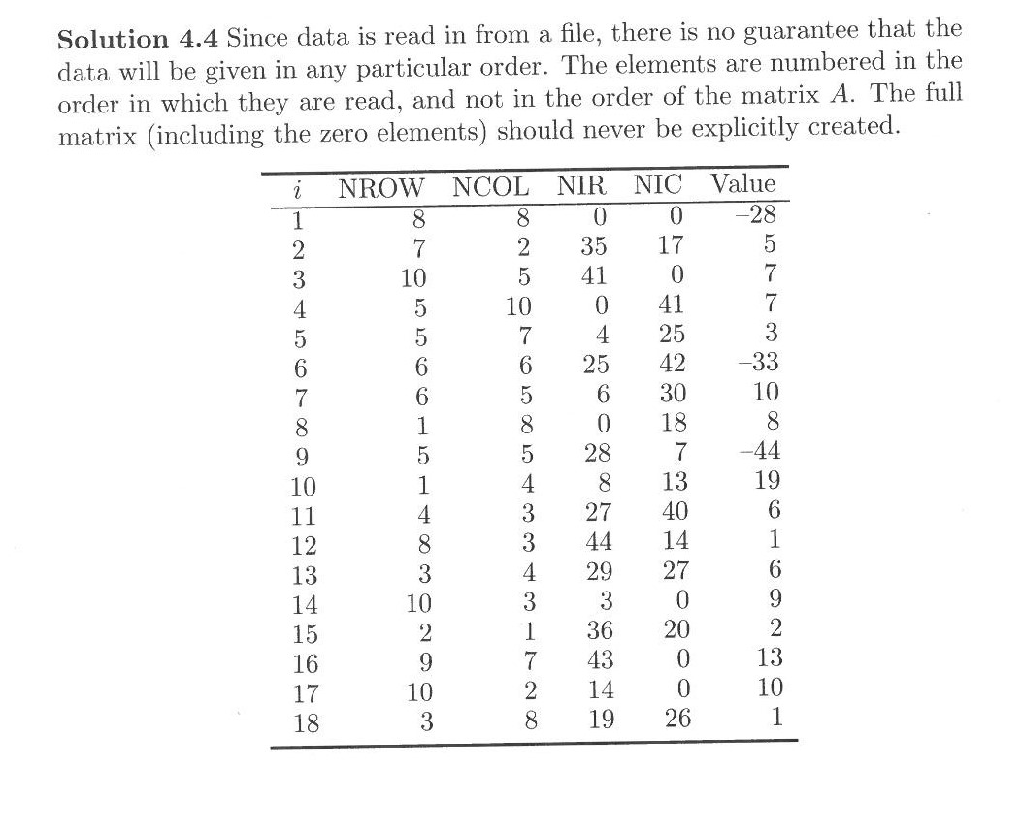
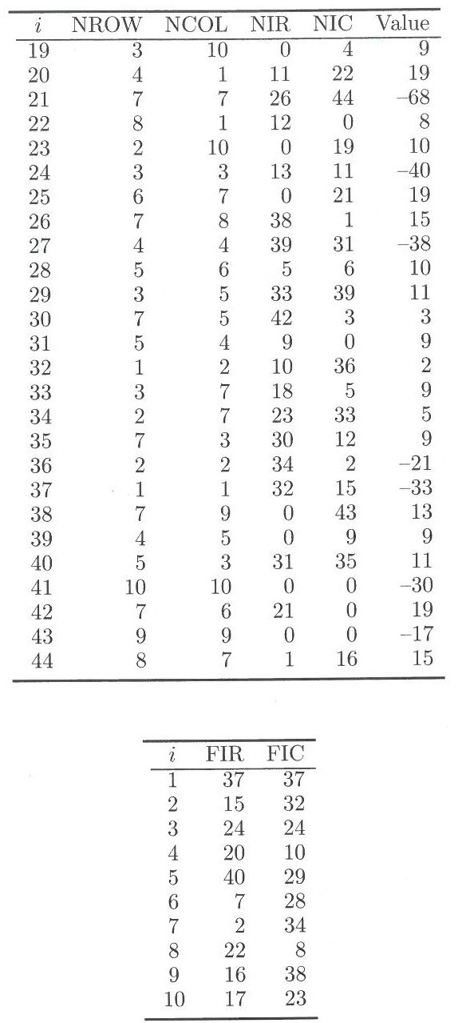
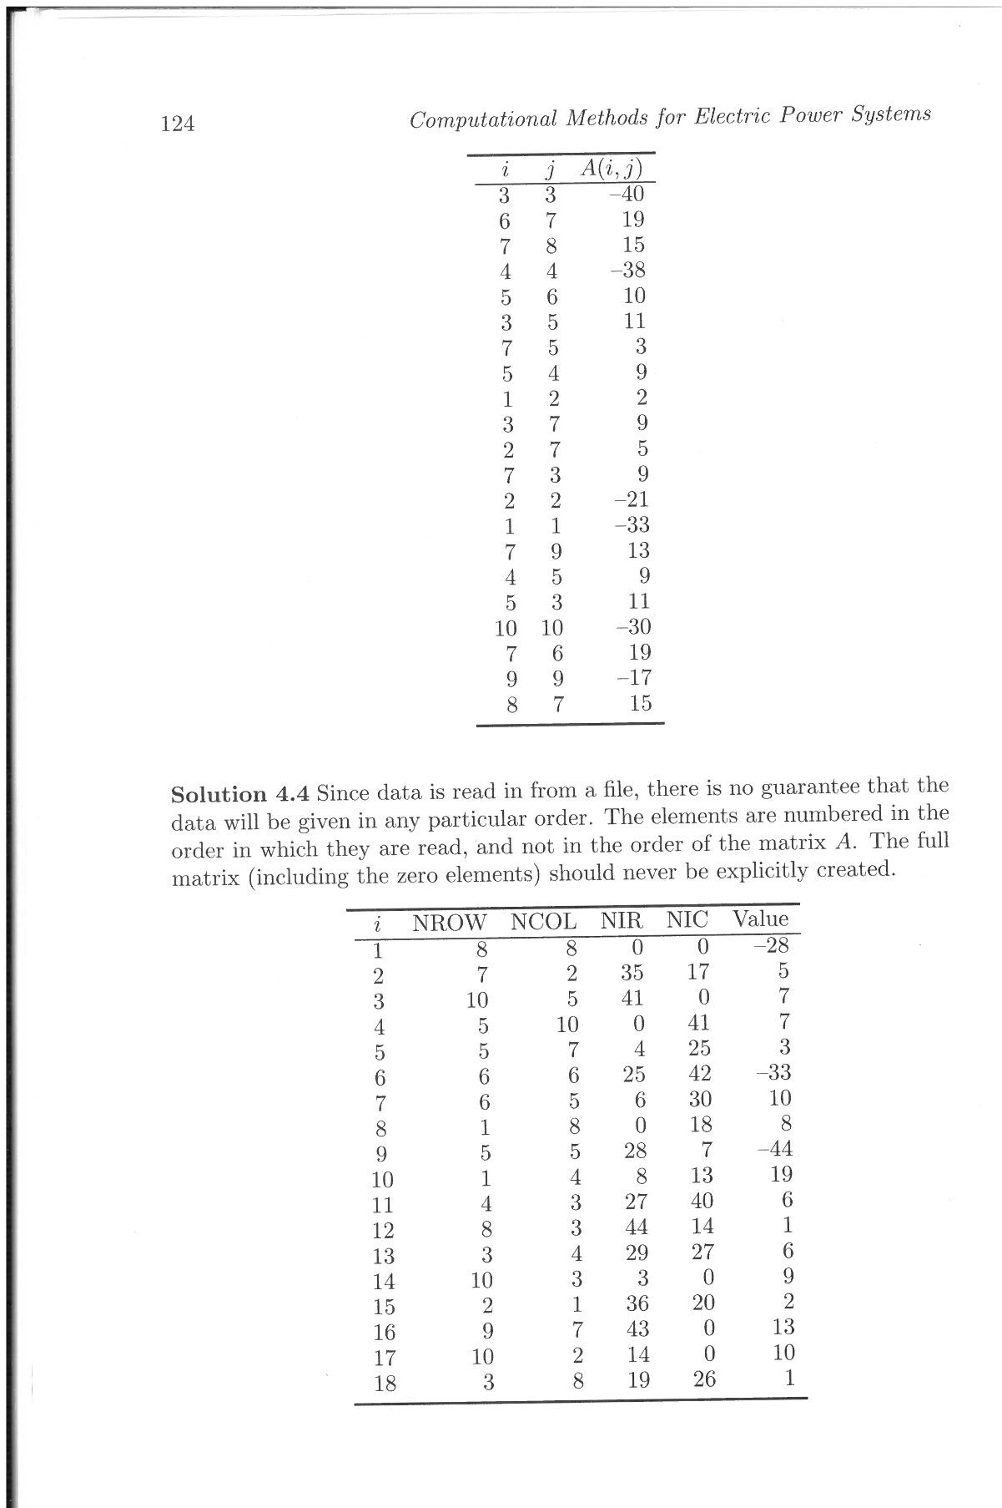
Example of Inputting Matrix values & making values

Slide 6
Example of Inputting Matrix values & making values
How would you calculate FIR & FIC?
How would you calculate NIR & NIC?

Slide 8
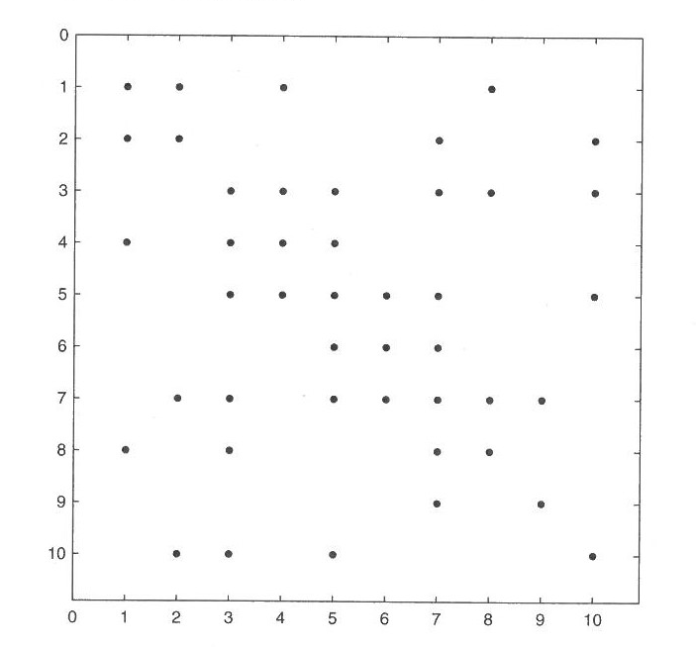
Example of Adding a New Term/Fill
45 2 4 X
46 2 8 X

Slide 9
Example of Adding a New Term/Fill
46
45
46
45
45 2 4 34 13 X
46 2 8 23 18 X
47 4 7 X
48 4 8 X
49 4 10 X

Slide 10
Program #2 – Sparse Matrices Program
Full Newton Raphson -- Take the Jacobian Matrix from Program #1 (with taps) and solve the problem using Sparse Matrix Techniques
Fast Decoupled Power Flow – Use Sparse Matrix Techniques for B’ and B’’ and solve. Use Scheme 0 to solve Fast Decoupled Power Flow
Extra Credit -- Fast Decoupled Power Flow – Use Sparse Matrix Techniques for B’ and B’’ and solve. Use Scheme 0 to solve Fast Decoupled Power Flow

Slide 11
NR Power Flow
Input Data
Calculate Jacobian Terms
with taps
L-U Factorization
Calculate Y_{bus}
Solve Equation [A][x] = [b]
Backward/ Forward Substitution
Calculate Jacobian Terms
Calculate Mismatch]
_{Iterative Solution}
Check Mismatch?
Small = enough
Output Results
Output Results

Slide 12
Program #2 Sparse Matrix NR Power Flow
Input Data
Calculate Jacobian Terms & Put in Sparse Storage
with taps
L-U Factorization
Calculate Y_{bus}
Solve Equation using Sparse Techniques [A][x] = [b]
Backward/ Forward Substitution
Calculate Jacobian Terms
Calculate Mismatch]
_{Iterative Solution}
Check Mismatch?
What changes in your code?
Small = enough
Output Results
Output Results

Slide 14
Program #2 Sparse Matrix Fast Decoupled
Input Data
Calculate B’ and B” & Put in Sparse Storage
with taps
L-U Factorization
Calculate Y_{bus}
Solve Equation using Sparse Techniques [A][x] = [b]
Backward/ Forward Substitution
Calculate Jacobian Terms
Calculate Mismatch]
_{Iterative Solution}
Check Mismatch?
What changes in your code?
Small = enough
Output Results
Output Results

Slide 16
Program #2 Sparse Matrix Fast Decoupled with Scheme 0
Input Data
Calculate B’ and B” & Put in Sparse Storage
with taps
Scheme 0 Reordering
L-U Factorization
Calculate Y_{bus}
Solve Equation using Sparse Techniques [A][x] = [b]
Backward/ Forward Substitution
Calculate Jacobian Terms
Calculate Mismatch]
_{Iterative Solution}
Check Mismatch?
What changes in your code?
Small = enough
Output Results
Output Results

Slide 18
Announcements
Finish Chapter 4
Review Sections 3.5.5 & 3.5.6
Papers for Discussion Set #1 –Questions – Today and Responses by 10/11
Work on Program #1
Set up Time for Program #1 Discussions

